Slide 1



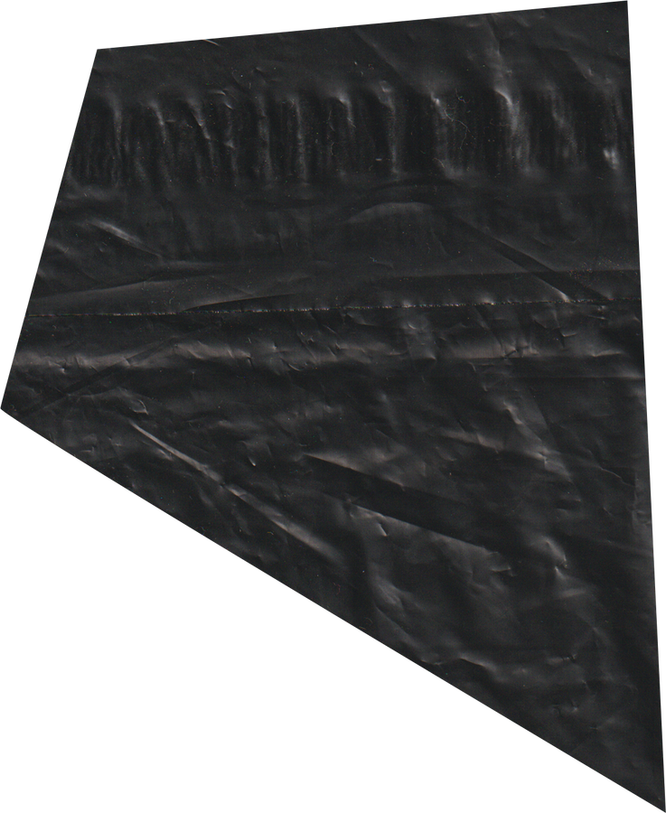


MIDTERM EXAM
AUTUM 2024
GROUP
DROPBOXUI
REPORT
GROUP 3

Slide 2


MIDTERM EXAM
INTRODUCTION
DropBox
STORAGE
DOWNLOAD
SHARE
GROUP 3

Slide 3
MIDTERM EXAM
TABLE OF CONTENT
1
ARCHITECTURE
3
OPTIMIZATION
2
ACTIVITIES
4
DEMO
GROUP 3

Slide 4
MIDTERM EXAM
WINTER 2030
ARCHITECTURE
GROUP 3

Slide 5
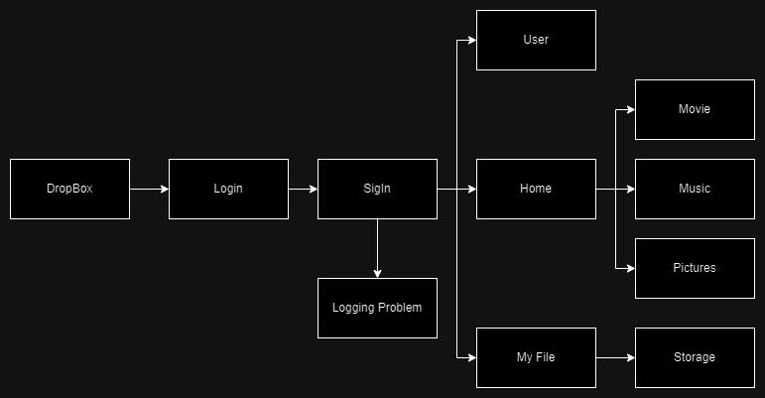
MIDTERM EXAM
GROUP 3

Slide 6
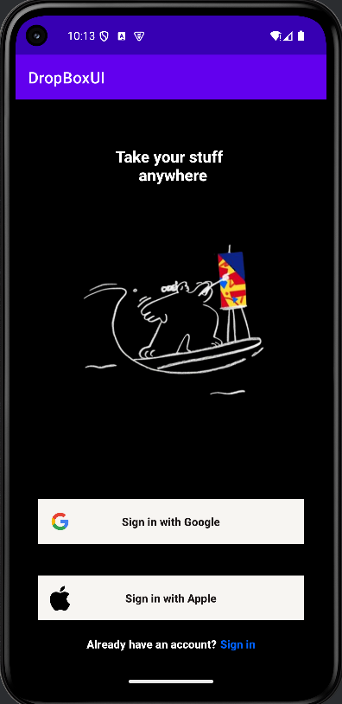
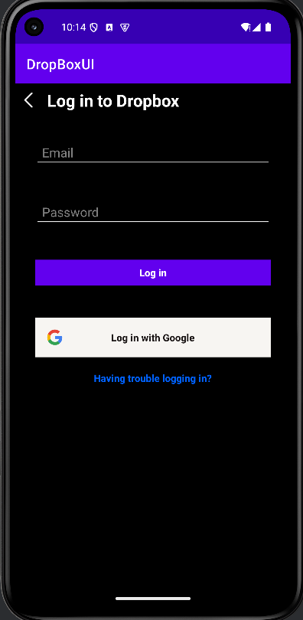
ARCHITECTURE
Login
GROUP 3

Slide 7


MIDTERM EXAM
ARCHITECTURE
main part
HOME
USERS
MY FILE
GROUP 3

Slide 8
MIDTERM EXAM
AUTUM 2024
ACTIVITIES
GROUP 3

Slide 9
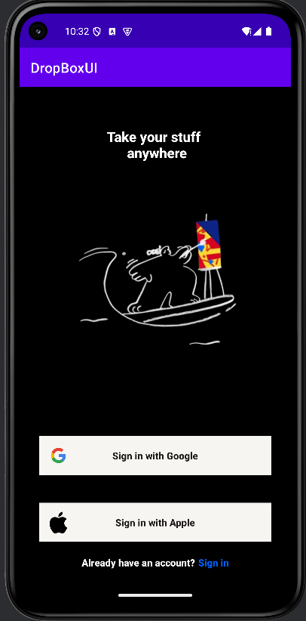
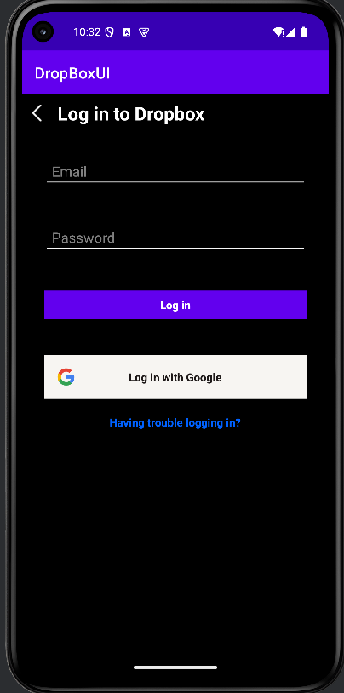
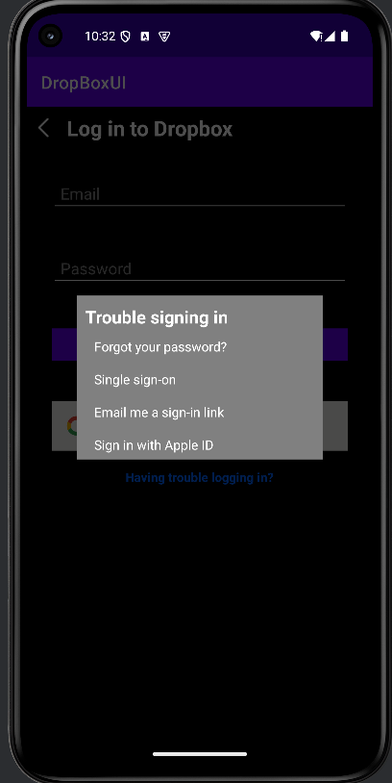
LOGIN
GROUP 3

Slide 10
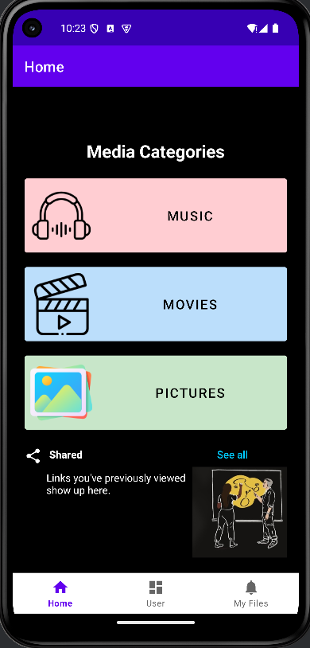
HOME
Music
Movies
pictures
GROUP 3

Slide 11
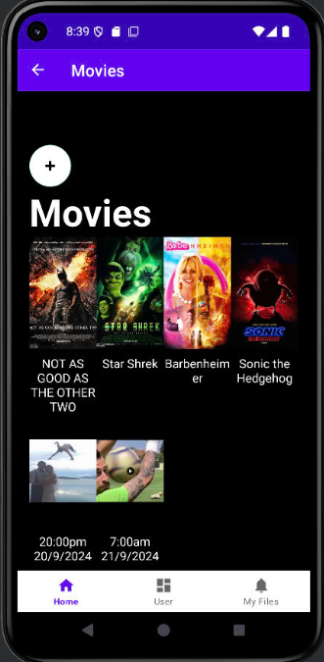
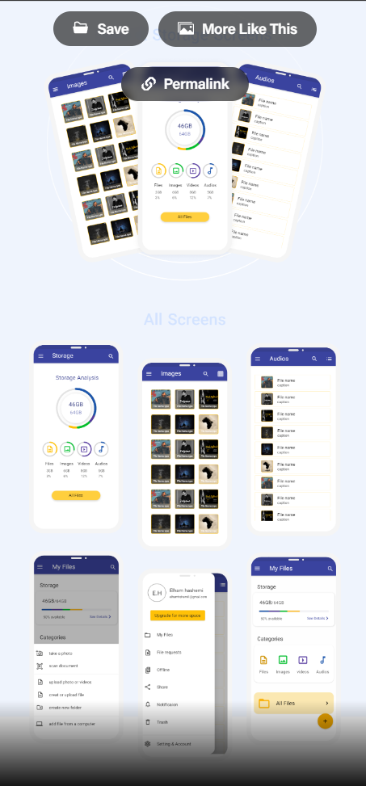
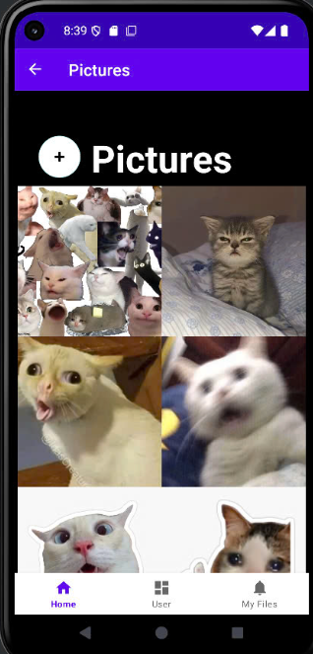
HOME
GROUP 3

Slide 12
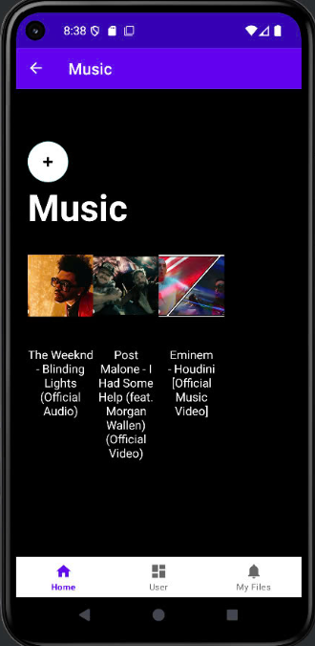
HOME
GROUP 3

Slide 13
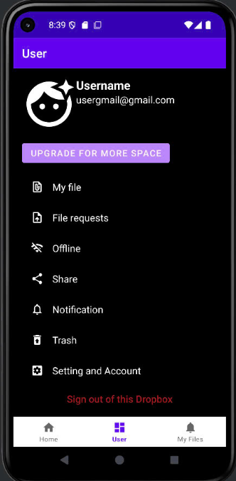
USER
GROUP 3

Slide 14
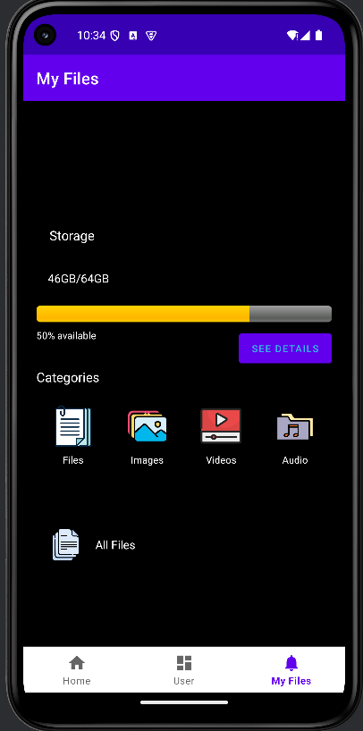
MY FILES
GROUP 3

Slide 15
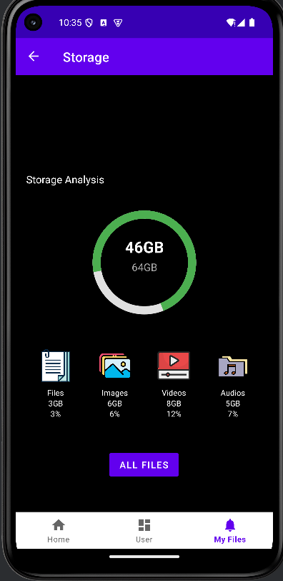
STORAGE
GROUP 3

Slide 16
MIDTERM EXAM
AUTUM 2024
OPTIMIZATION
GROUP 3

Slide 17
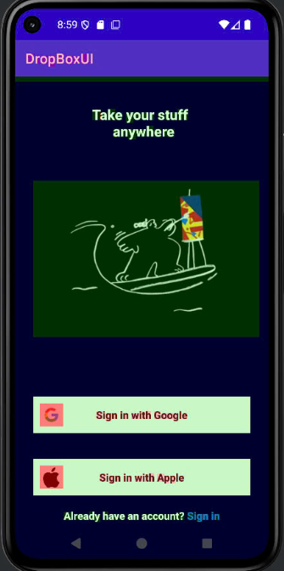
Normal
GPU Overdrawn enable
SIGN IN
GROUP 3

Slide 18
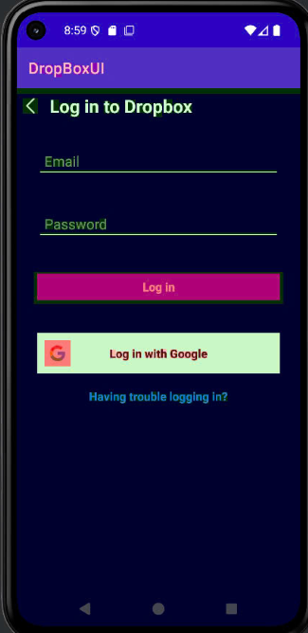
Normal
GPU Overdrawn enable
LOGIN
GROUP 3

Slide 19
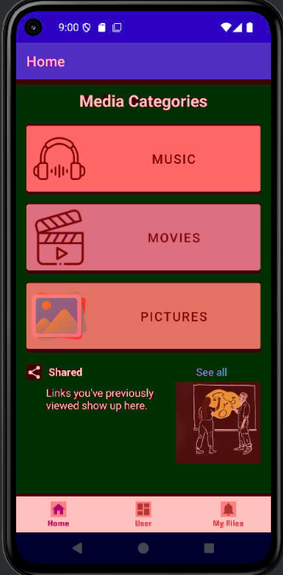
Normal
GPU Overdrawn enable
HOME
GROUP 3

Slide 20
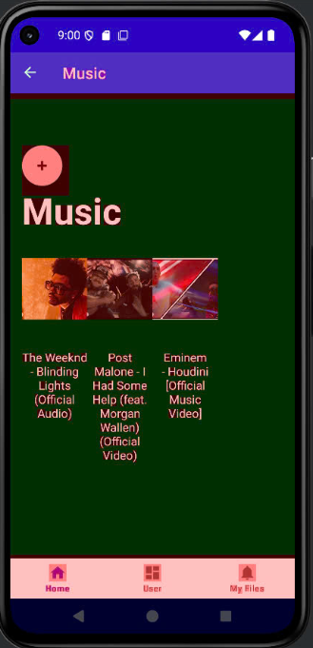
Normal
GPU Overdrawn enable
MUSIC
GROUP 3

Slide 21
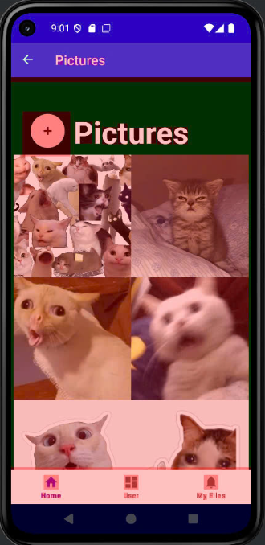
Normal
GPU Overdrawn enable
PICTURES
GROUP 3

Slide 22
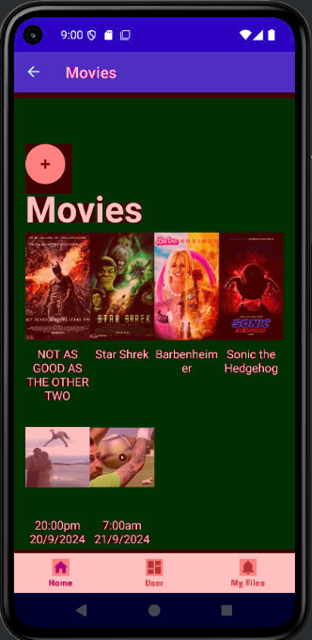
Normal
GPU Overdrawn enable
PICTURES
GROUP 3

Slide 23
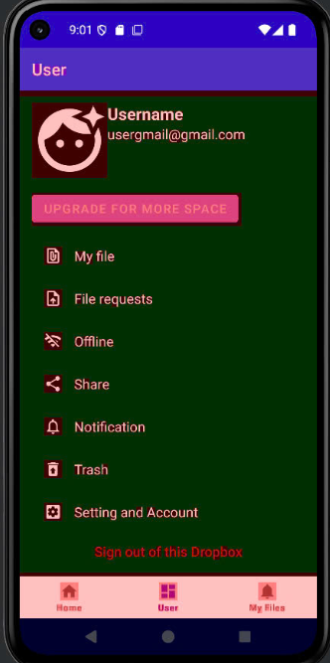
Normal
GPU Overdrawn enable
USER
GROUP 3

Slide 24
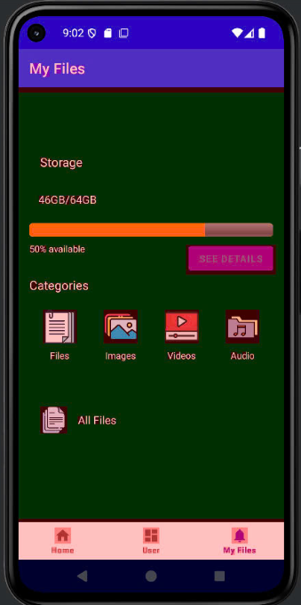
Normal
GPU Overdrawn enable
MY FILES
GROUP 3

Slide 25
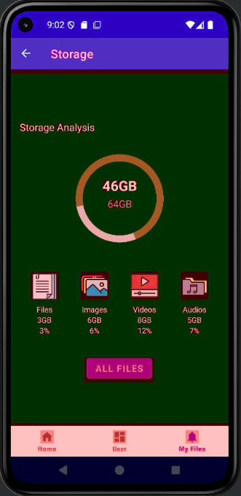
Normal
GPU Overdrawn enable
STORAGE
GROUP 3

Slide 26



@REALLYGREATSITE
CONCLUSION
DONE MOST OF THE UI
SOME SMALL FUNCTION ISN’T WORKING AT THE MOMENT
FINISHED THE APP
IMPROVE AND ADD MORE FUNCTIONS
GROUP 3

Slide 27
MIDTERM EXAM
WINTER 2030
DEMO
GROUP 3

Slide 28
MIDTERM EXAM
GROUP
1
DANG MINH DUY -MY FILE, STORAGE
2
NGO HAI ANH - USER
3
NGUYEN PHUC KHANG - MUSIC, MOVIE, PICTURE
4
NGUYEN DUY HAI - HOME
5
LA DUY ANH - LOGIN
GROUP 3

Slide 29
MIDTERM EXAM
AUTUM 2024
THANK YOU
GROUP 3

